Slide 1
NLP

Slide 2
Introduction to NLP
Probabilistic Parsing

Slide 3
Main Tasks with PCFGs
Given a grammar G and a sentence s, let T(s) be all parse trees that correspond to s
Task 1
find which tree t among T(s) maximizes the probability p(t)
Task 2
find the probability of the sentence p(s) as the sum of all possible tree probabilities p(t)

Slide 4
Probabilistic Parsing Methods
Probabilistic Earley algorithm
Top-down parser with a dynamic programming table
Probabilistic Cocke-Kasami-Younger (CKY) algorithm
Bottom-up parser with a dynamic programming table

Slide 5
Probabilistic Grammars
Probabilities can be learned from a training corpus
Treebank
Intuitive meaning
Parse #1 is twice as probable as parse #2
Possible to do reranking
Possible to combine with other stages
E.g., speech recognition, translation

Slide 6
Maximum Likelihood Estimates
Use the parsed training set for getting the counts
P_{ML}(α→β) = Count (α→β)/Count(α)
Example:
P_{ML}(S→NP VP) = Count (S→NP VP)/Count(S)
Notes:
Example

Slide 7
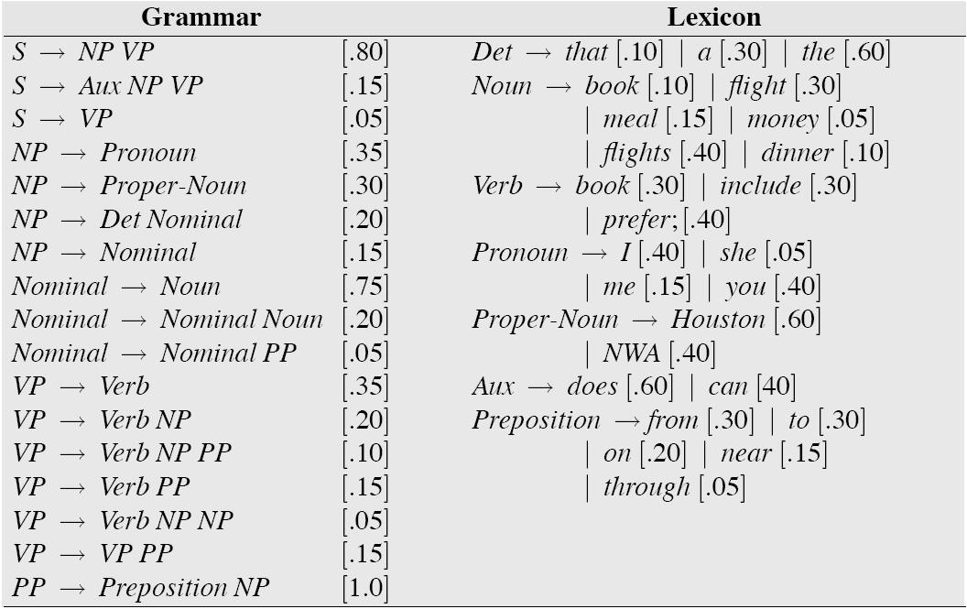
Sample Probabilistic Grammar
Example from Jurafsky and Martin
Notes:
Replace!!!

Slide 8
Example
S -> NP VP [p0=1]
NP -> DT N [p1=.8]
NP -> NP PP [p2=.2]
PP -> PRP NP [p3=1]
VP -> V NP [p4=.7]
VP -> VP PP [p5=.3]
DT -> 'a' [p6=.25]
DT -> 'the' [p7=.75]
N -> 'child' [p8=.5]
N -> 'cake' [p9=.3]
N -> 'fork' [p10=.2]
PRP -> 'with' [p11=.1]
PRP -> 'to' [p12=.9]
V -> 'saw' [p13=.4]
V -> 'ate' [p14=.6]

Slide 9
the
child
ate
the
cake
with
the
fork

Slide 10
the
DT
.75
child
ate
the
cake
with
the
fork

Slide 11
the
DT
.75
child
N
.5
ate
the
cake
with
the
fork

Slide 12
the
DT
.75
NP
.8
child
N
.5
ate
the
cake
with
the
fork

Slide 13
the
DT
.75
NP
.8*.5*.75
child
N
.5
ate
the
cake
with
the
fork

Slide 14
the
DT
.75
NP
.8*.5*.75
child
N
.5
ate
the
cake
with
the
Keep only the highest score in each cell
fork

Slide 15
Exercise
Now, on your own, compute the probability of the entire sentence using Probabilistic CKY.
Don’t forget that there may be multiple parses, so you will need to add the corresponding probabilities.

Slide 16
Notes
Stanford Demo
http://nlp.stanford.edu:8080/parser/
PTB statistics
50,000 sentences (40,000 training; 2,400 testing)
PTB peculiarities
includes traces and other null elements
Flat NP structure (e.g., NP -> DT JJ JJ NNP NNS)
Parent transformation
Subject NPs are more likely to be modified than object NPs
E.g., replace NP with NP^S
Notes:
Some of these sentences are repeated in other slides.

Slide 17
NLP

